Slide 1
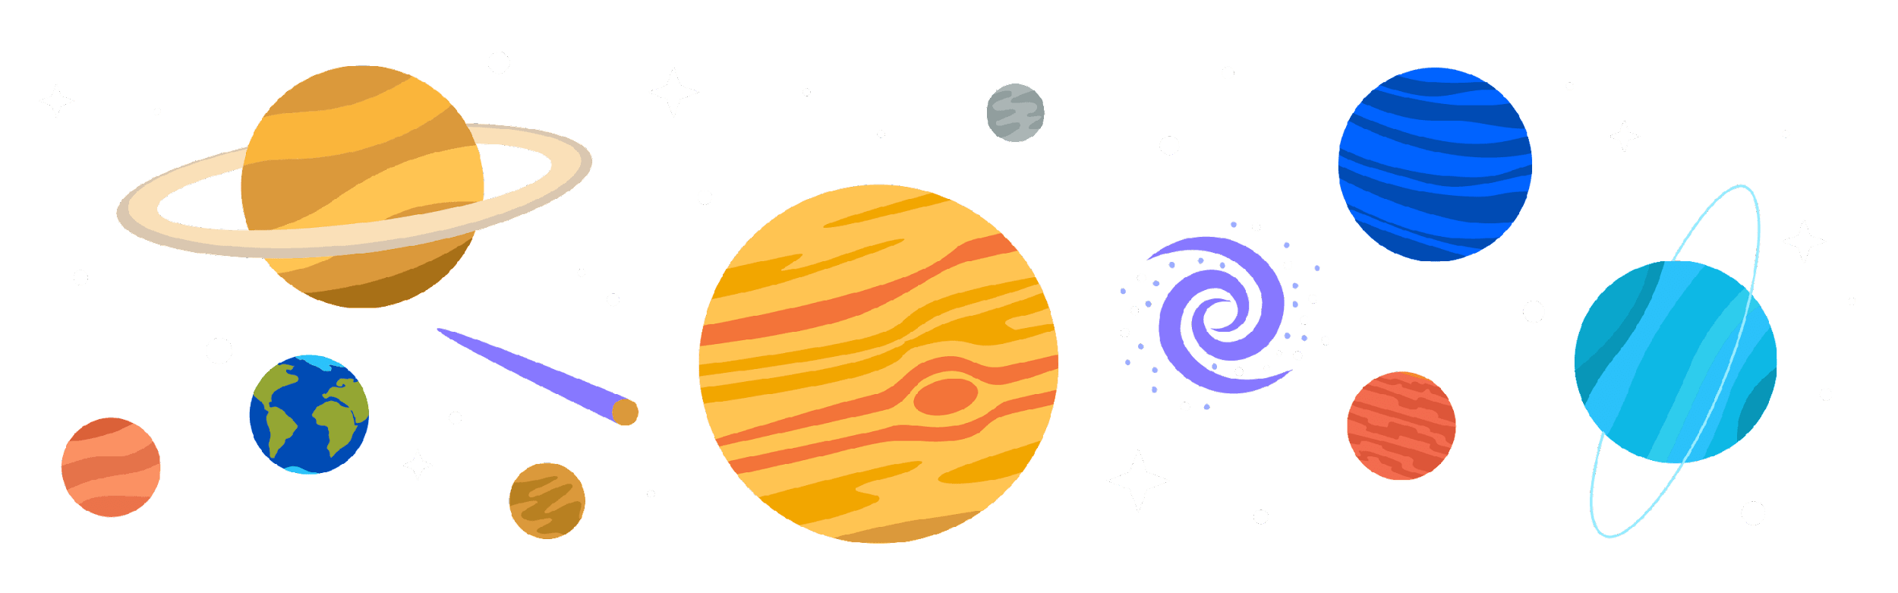
The big bang How our universe began
Chapter 34

Slide 2
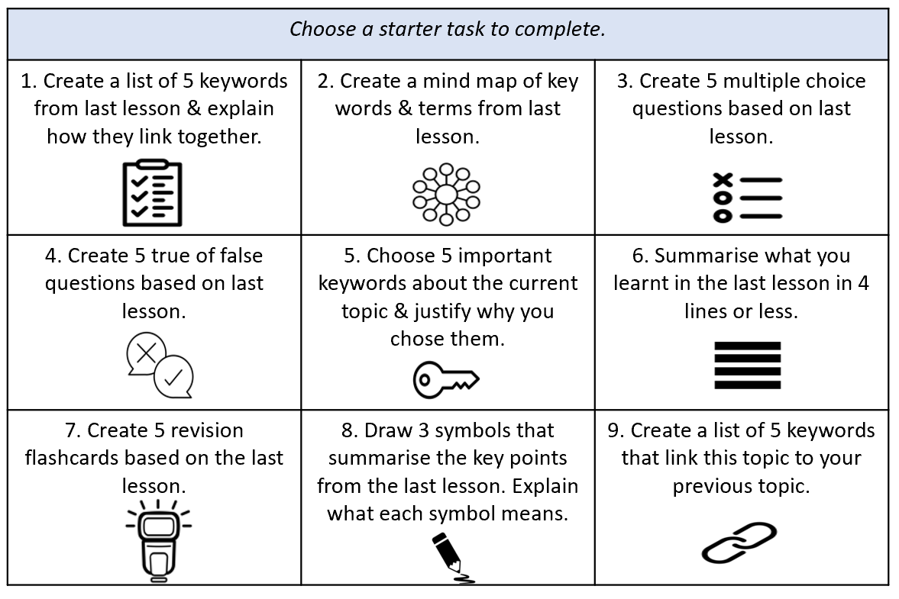

Slide 3
Write out a simple explanation of what each key word means
Universe
Singularity
Solar system
Galaxy
Space
Astronomy

Slide 4
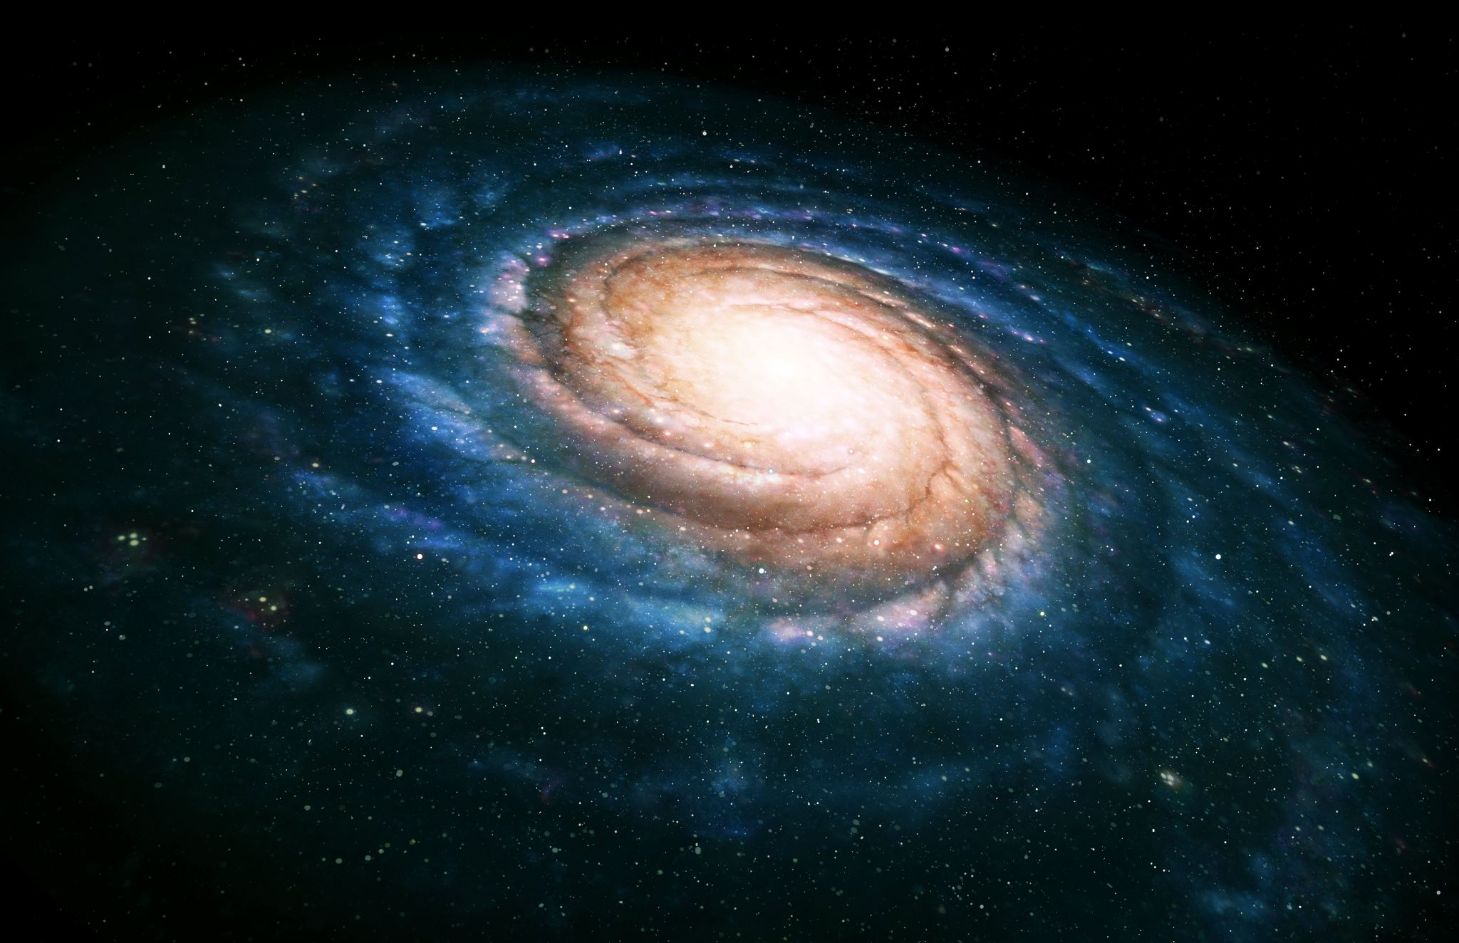
What is the universe ?
Is a vast area of space within which we find all the galaxies, stars and solar systems

Slide 5
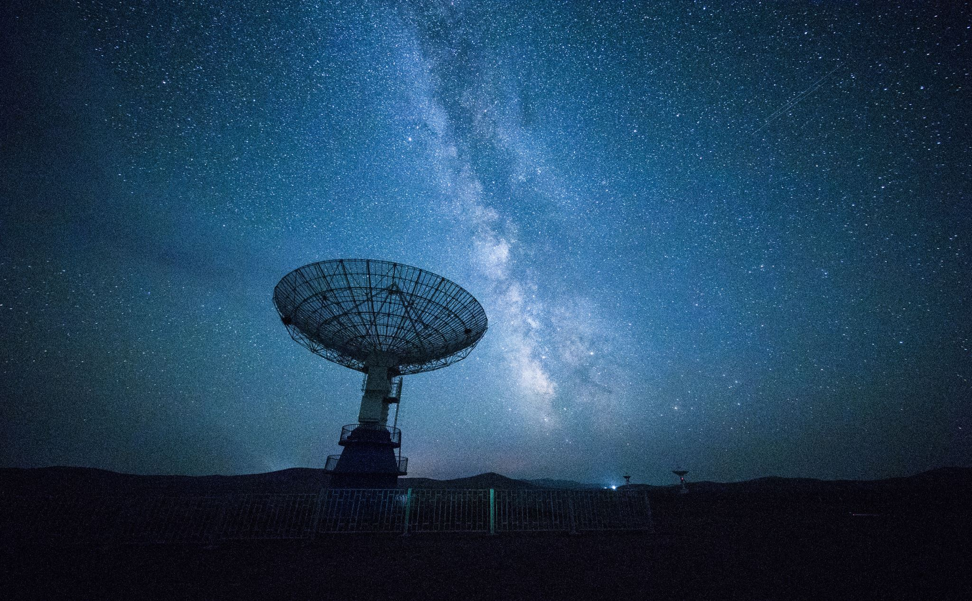
Astronomy
Astronomy is the study of everything in the universe beyond Earth's atmosphere.

Slide 6
Edwin Hubble – US Astronomer
1992, Edwin Hubble discovered that the universe was expanding.
He discovered that all objects in the universe are moving away from each other.
He noted that the universe was expanding, but it was expanding at a great rate.
Hubble's discovery became known as Hubble’s law

Slide 7
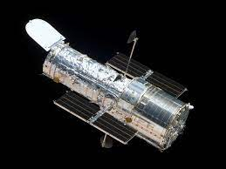
Hubble’s Law
Galaxies are moving away from each other.
The farther away a galaxy is, the faster the galaxy is moving away from us.
Until then, astronomers believed that the universe was a fixed size.
Hubble's discovery was so important that the Hubble space telescope was named after him.
Notes:
https://cdn.edcolearning.ie/Resource/Url?bookId=book979&chapterId=chapter38&pageId=page398&fileName=asc5441s_embedded_video_chpt34_pg386_1.mp4&device=WebApp&token=dABlAGEAYwBoAGUAcgAjACMAMAA4ADQAOQAwADIAZQA3AC0AYgBhADkAMAAtADQAOQA1AGUALQA4ADUAZQA5AC0ANgA3ADEAYwBhAGMAMAAyAGUAMgBkAGIAIwAjADYAMwA3ADQANwAxADkANQAzADAAOAA4ADMANgA1ADEAMgA2AA==

Slide 8
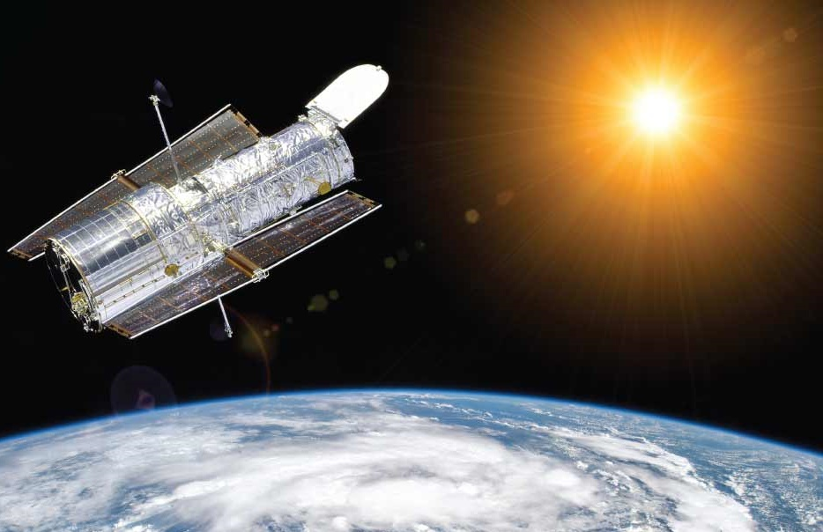
Why is the Hubble Space Telescope so important?
The Hubble Space Telescope, which was launched by NASA in 1990, is named after Edwin Hubble. The Hubble Space Telescope is extremely important for furthering our knowledge of space.
Normally when we look into space we are looking through telescopes that are located on Earth.
Notes:
https://www.youtube.com/watch?v=IbMOHclEuj4

Slide 9
Homework - pg 387 Q 43.6
Research the main discoveries that scientists have made about the universe.
In your research identify four key discoveries that have been made about the planet, galaxy or universe.
Famous scientists you can research:
Edwin Hubble
Albert Einstein
Stephen hawking
Isaac Newton
Robert Woodrow Wilson

Slide 10
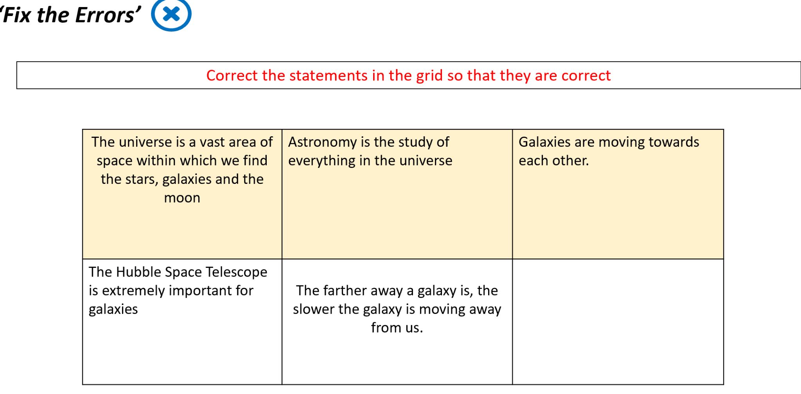

Slide 11
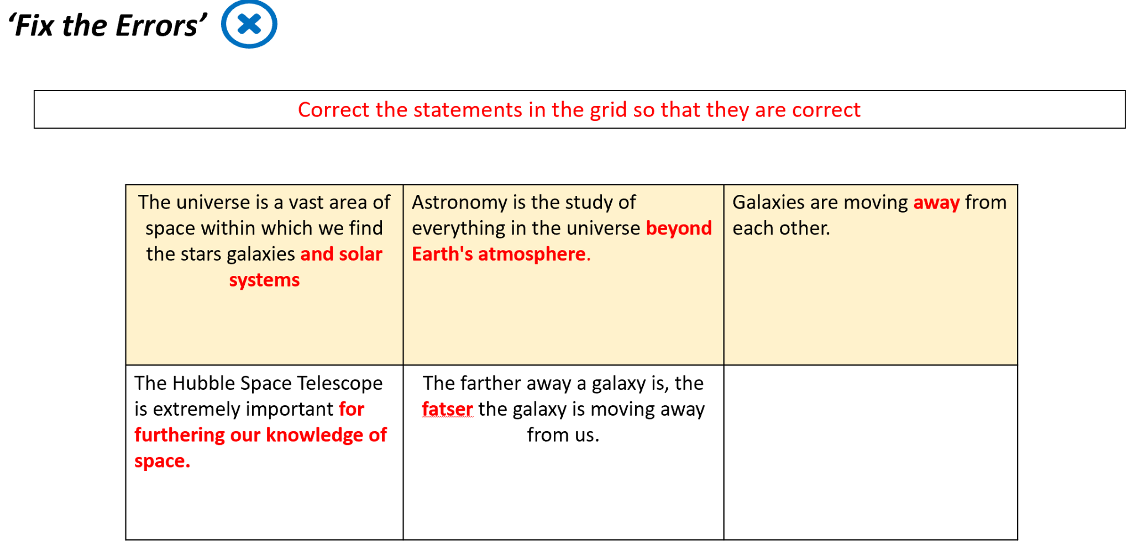

Slide 12

1. Describe a singularity
2. Explain the starting point of the universe
3. Explain what happened after the Big Bang

Slide 13

The big bang theory

Slide 14
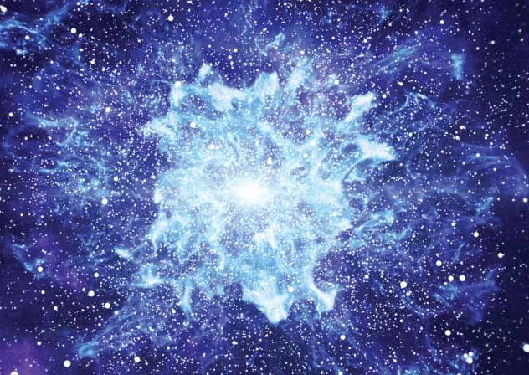
The big bang
The term ‘bang’ suggests that there was an explosion of some form.
But this is not actually what happened at the start of the universe.
Time, space and matter all began with the Big Bang.
Notes:
https://www.esa.int/kids/en/learn/Our_Universe/Story_of_the_Universe/The_Big_Bang

Slide 15
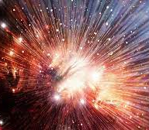
The big bang Starting point
Edwin Hubble concluded that there must have been a single moment when the entire universe was held within a single zone.
This was the beginning of the universe, which Hubble’s observations put at around 13.8 billion years ago.
Expanding rapidly from a very dense and hot, tiny single point called a singularity.
Singularity: a zone that is very small, very dense and very hot.

Slide 16
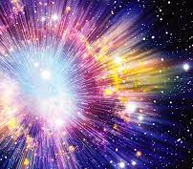
The big bang
The singularity was a region so intensely hot that the normal particles of matter did not exist.
Within a single moment this intensely hot singularity expanded rapidly. This is what we term the Big Bang.
In the first few moments after the Big Bang the universe was so hot that we cannot imagine a level of temperature that great.

Slide 17
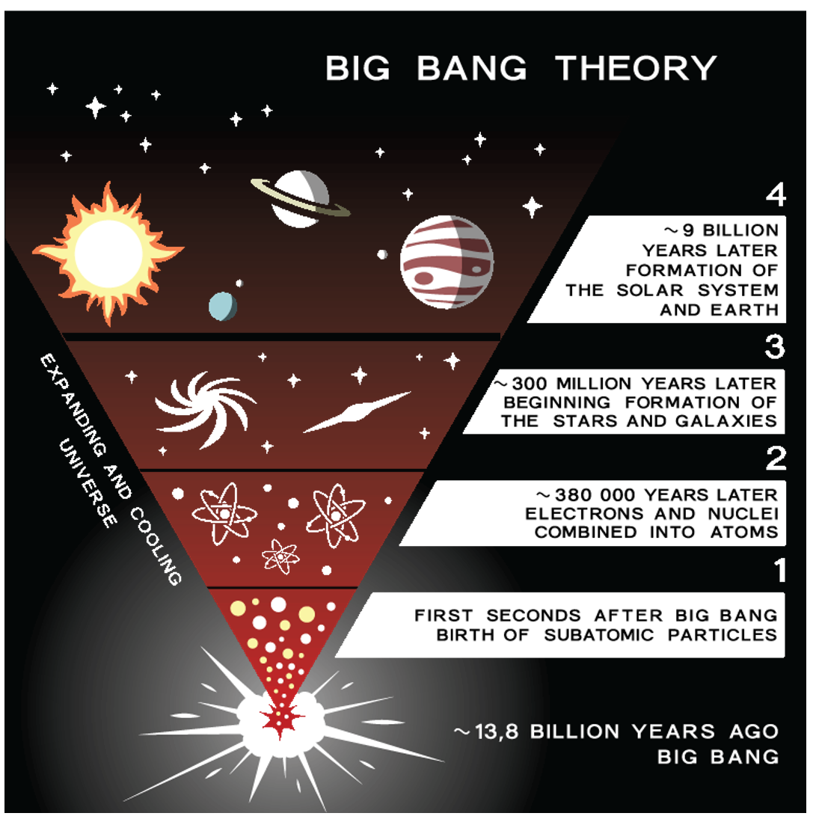
After the big bang
As the universe continued to expand it began to cool.
The cooler temperature allowed particles to exist, energy changed into particles of matter
Now cool enough for light to begin to travel through the universe.
Notes:
Within minutes, particles of matter formed atoms of hydrogen and helium. Those atoms later formed stars, which led to the creation of planets.

Slide 18
https://kids.britannica.com/kids/article/big-bang/399364

Slide 19
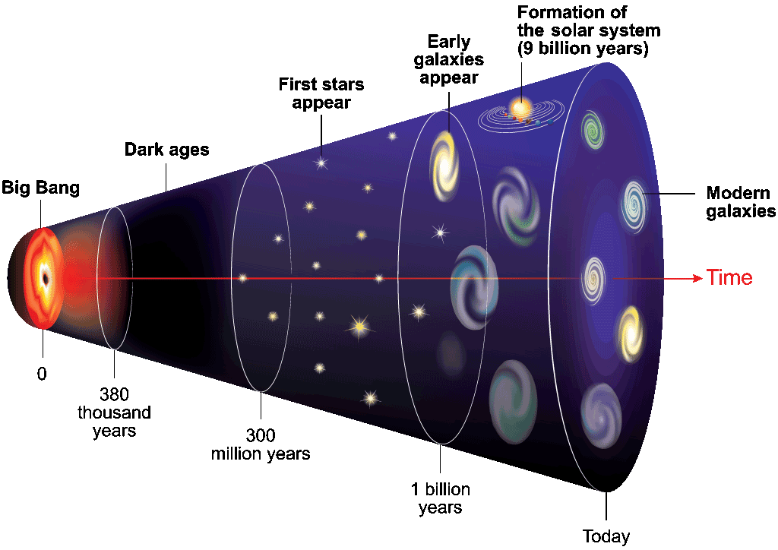
The big bang theory conclusion The universe expanding ever since the Big Bang
The Big Bang theory is only one of the explanations for the formation of the universe.
Our galaxy is also one of many other galaxies that make up the universe.
The exact answer to how our universe began is still unknown. Scientists continue to look for an explanation for the origin of our universe.

Slide 20
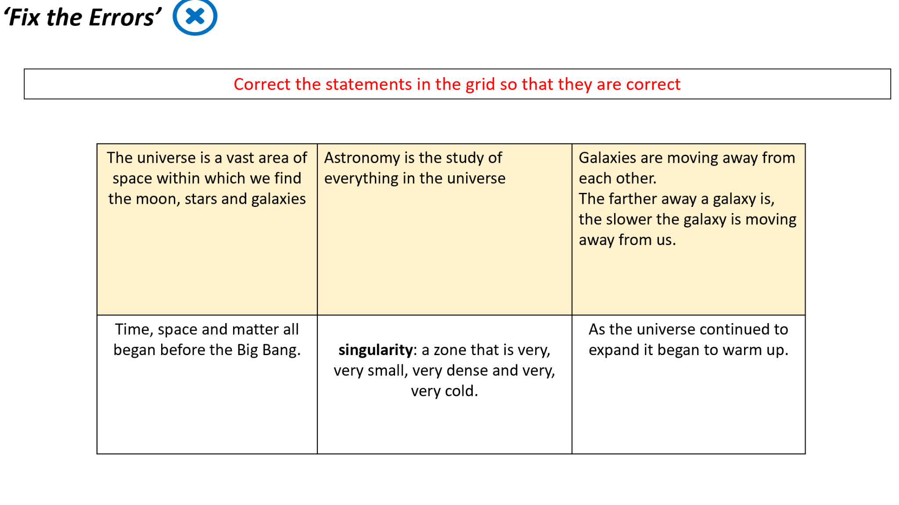

Slide 21
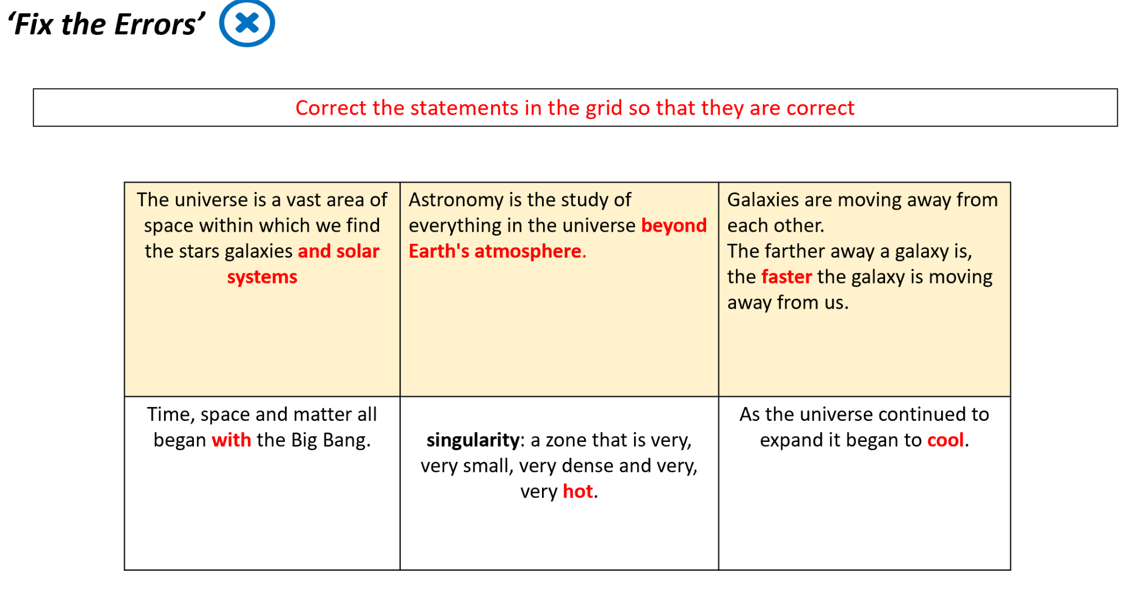

Slide 22
